Slide 1
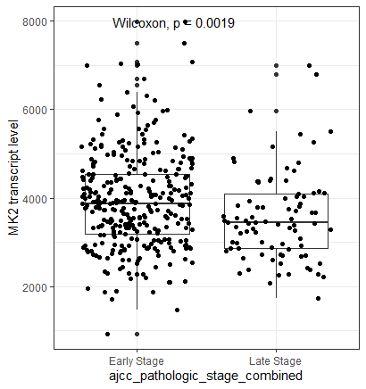
Boxplot show mean+/- SD of MK2 transcript levels in the TCGA-LUAD (Lung cancer) dataset. We divided the tumor stage into Early (Stage I-IIB) and Late (Stage IIIA and IV). MK2 expression was extracted from TCGA mRNA sequencing data

Slide 2
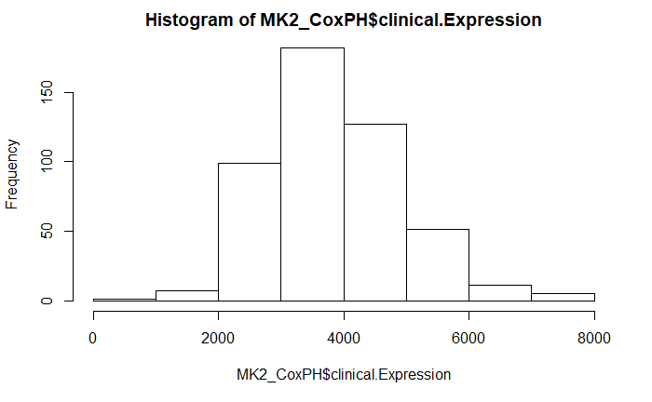
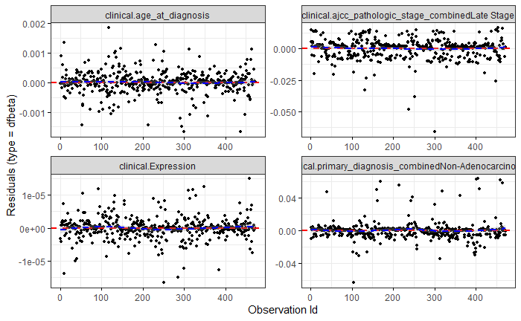
Cox Proportional Hazard model results – MK2 transcript levels treated as a continuous variable
Variable | HR | 95% CI
MK2 expression | 1.0 | (0.99,1.0)
Late Stage cancer | 2.57 | (1.82,3.62)
Non-Adenocarcinoma histology | 0.47 | (0.29,0.78)
Age at diagnosis | 1.01 | (0.99,1.02)
We are interested in assessing the impact of MK2 transcript levels on survival. So, we first treated MK2 as a continuous variable (no binning into “high” or “low” transcript levels). Top left: Histogram showing distribution of MK2 transcript values in the dataset. Top right: Diagnostics (residuals) for the variables in a Cox PH model that includes age, tumor stage, MK2 transcript level (clinical.Expression) and tumor histology. The residuals look uniformly distributed. Bottom left: Results of the Cox PH model showing that, when we model MK2 as a continuous variable, no association between MK2 transcript level and survival.

Slide 3
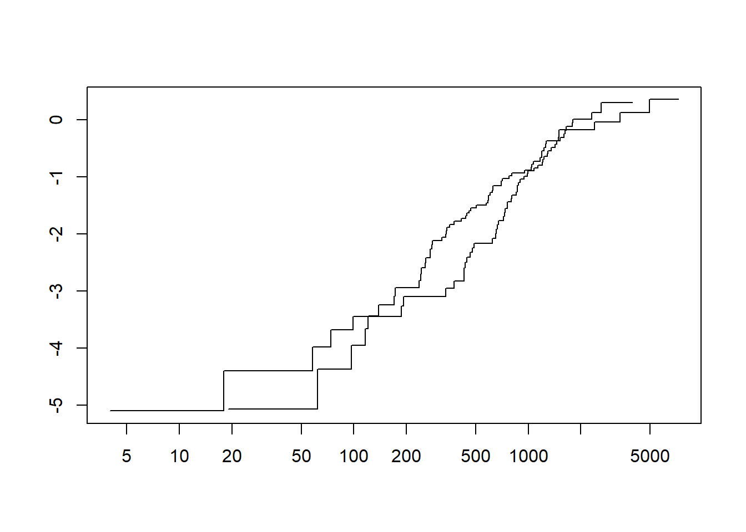
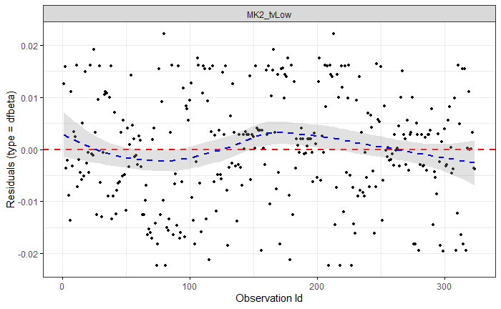
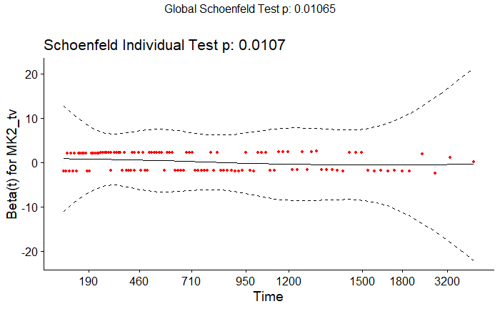
Cox Proportional Hazard model diagnostics when MK2 classified as categorical (high vs. low)
Log(-log(survival))
Log(time)
Since we’re interested in what happens when MK2 protein levels are altered, we re-categorized MK2 transcript levels in “high” (top 1/3rd) and “low (bottom 1/3rd). Now, this categorical variable (MK2 = “high” or “low”) was used in the Cox PH model. Diagnostic plots of Residuals (left side) and QQ plots (right upper) show that when coded this way, this variable violates PH assumption testing.

Slide 4
Cox Proportional Hazard model results – MK2 classified as high or low
Early Stage |  | Model 1^{b} |  | Model 2^{c}
 |  | HR | 95%CI | HR | 95% CI
High MK2ª | 0-1yr | 0.26 | (0.08,0.80) | 0.27 | (0.08,0.85)
 | 1-2yrs | 0.93 | (0.36,2.42) | 1.05 | (0.39,2.82)
 | 2-3yrs | 2.83 | (0.92,8.71) | 2.55 | (0.82, 7.95)
 | >3yrs | 1.53 | (0.65,3.62) | 1.39 | (0.58,3.33)
Late Stage |  | Model 1 |  | Model 2
 |  | HR | 95%CI | HR | 95% CI
High MK2 | 0-1yr | 0.65 | (0.20, 2.12) | 0.64 | (0.19,2.09)
 | 1-2yrs | 0.56 | (0.19, 1.65) | 0.54 | (0.18,1.60)
 | 2-3yrs | 0.75 | (0.10,5.37) | 0.78 | (0.10,5.64)
 | >3yrs | 0.64 | (0.10, 3.95) | 0.71 | (0.11,4.55)
ª Top 1/3 of MK2 mRNA transcript levels. Reference: bottom 1/3 of mRNA transcript levels
^{b} Model 1: MK2 transcript level:time strata(0-1yr; 1-2yrs; 2-3yrs; >3yrs)
^{c} Model 2: Model 1 + age at diagnosis + gender+ smoking status
Since MK2, as a categorical variable, is time-varying, we stratified the results of the model by time. We are mostly interested in what happens in the first year after diagnosis. Thus, we ran a univariate (Model 1) and multivariate (Model 2) Cox PH model to assess the effect of high MK2 (compared to low MK2) levels on survival in the first 1 year (as well as years 1-2, 2-3, etc).

Slide 5
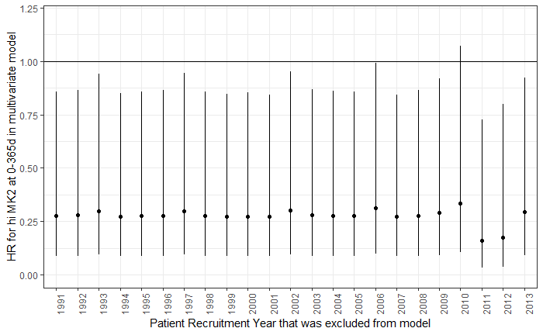
Early Stage |  | Model 1^{b} |  | Model 2^{c}
 |  | HR | 95%CI | HR | 95% CI
High MK2ª | 0-1yr | 0.26 | (0.08,0.80) | 0.27 | (0.08,0.85)
Patient recruitment into this dataset spanned many years, and chemo regimens and other practices change over time. To determine whether this is playing a role, we repeated the Cox PH model from the previous slide, and looked just at the 0-1 year Hazard Ratio in Early stage (shown in the table above). Now, we repeated the Cox PH model with each patient recruitment year excluded (sort of a jackknife type approach), and we plotted the HR and CIs. We can see here that the point estimates are stable even when we exclude any one particular year of recruitment.

Slide 6
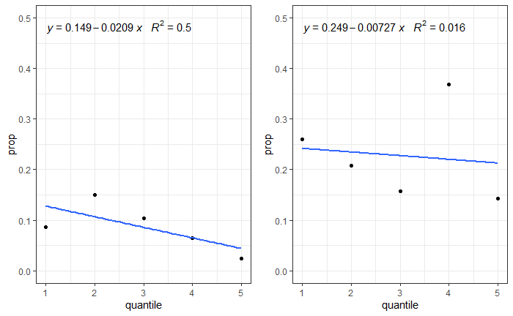
Early stage
Late stage
Graphs showing proportion of people who died within each quantile of MK2 expression in early- and late-stage NSCLC

Slide 7
Logistic regression – risk of death at 1 year
Variable | Model 1ª OR (95% CI) | Model 2^{b} OR (95% CI)
Male Sex | 1.84 (1.03,3.30) | 1.84 (1.03,3.3)
Smoking | 0.74 (0.40,1.37) | 0.74 (0.4,1.37)
MK2 Expression:Early Stage^{c} | 0.69 (0.51,0.94) | 0.69 (0.50,0.94)
MK2 Expression: Late Stage | 0.95 (0.69,1.30) | 0.94 (0.69,1.30)
Caspase-3^{c} | - | 0.92 (0.40,2.1)
ª Model 1 : Y(x) = β₀ + β₁(Sex) + β₂(Smoking) + β₃ (MK2 Expression):Stage
^{b} Model 2: Model + caspase-3 expression
^{c} OR of death at one year per 1000 transcripts

Slide 8
Combined LUAD and LUSC datasets

Slide 9
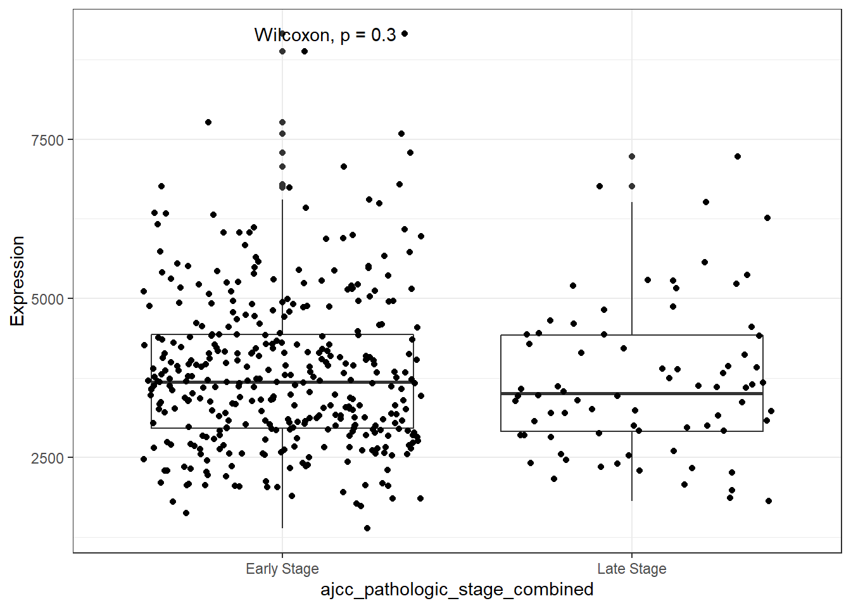
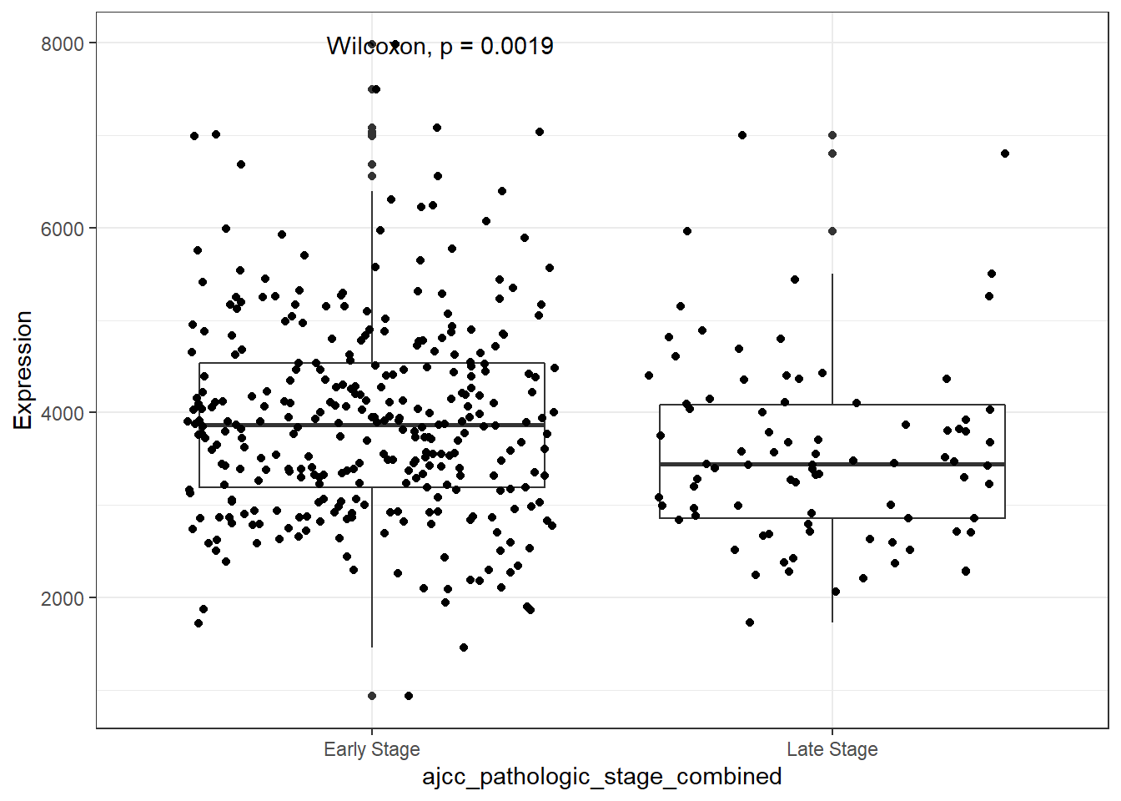
Combined LUAD and LUSC datasets
Adenocarcinoma
Squamous Cell
Boxplot show mean+/- SD of MK2 transcript levels in the TCGA-LUAD (adenocarcinoma) and the TCGA-LUSC (Squamous cell) dataset. We divided the tumor stage into Early (Stage I-IIB) and Late (Stage IIIA and IV). MK2 expression was extracted from TCGA mRNA sequencing data

Slide 10
Pan Cancer Analysis
Here, we ask the question: is this relationship between MK2 transcript and improved 1 year survival in early stage cancer something that is specific to lung adenocarcinoma, or do we see this in other tumor types. For this, we downloaded MK2 transcript data and clinical data for a variety of tumor types.

Slide 11
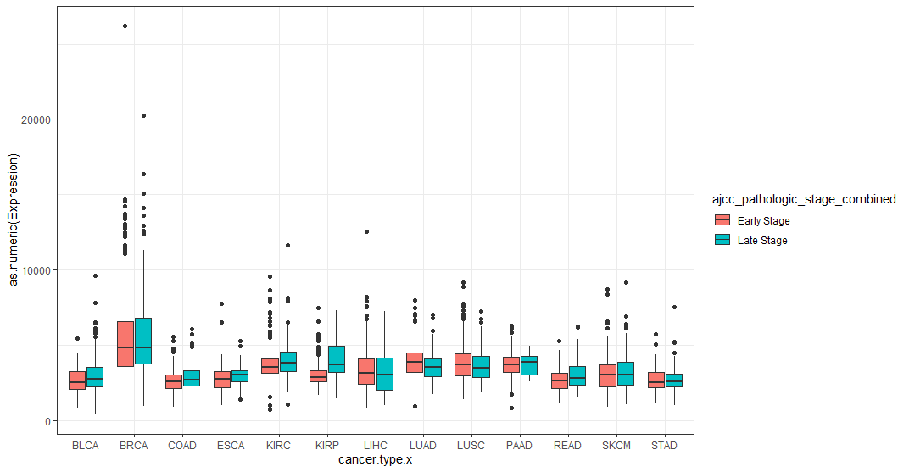
Boxplot show mean+/- SD of MK2 transcript levels in early vs. late stage cancer across cancer types. BLCA=bladder cancer, BRCA=breast cancer, COAD=colon adenocarcinoma; ESCA=Esophageal carcinoma; KIRC= Kidney renal clear cell carcinoma; KIRP=kidney renal papillary cell carcinoma; LIHC=liver hepatocellular carcinoma; LUAD=Lung adenocarcinoma; LUSC=Lung Squamous cell carcinoma; PAAD=pancreatic adenocarcinoma; READ=rectum adenocarcinoma; SKCM=skin cutaneous melanoma; STAD=stomach adenocarcinoma

Slide 12
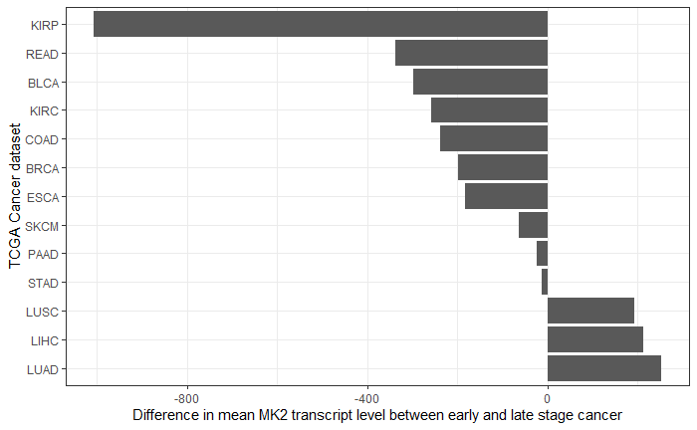
Bar graphs showing difference in MK2 transcript levels between early and late (i.e. Early-late transcript level) across cancer types. BLCA=bladder cancer, BRCA=breast cancer, COAD=colon adenocarcinoma; ESCA=Esophageal carcinoma; KIRC= Kidney renal clear cell carcinoma; KIRP=kidney renal papillary cell carcinoma; LIHC=liver hepatocellular carcinoma; LUAD=Lung adenocarcinoma; LUSC=Lung Squamous cell carcinoma; PAAD=pancreatic adenocarcinoma; READ=rectum adenocarcinoma; SKCM=skin cutaneous melanoma; STAD=stomach adenocarcinoma

Slide 13
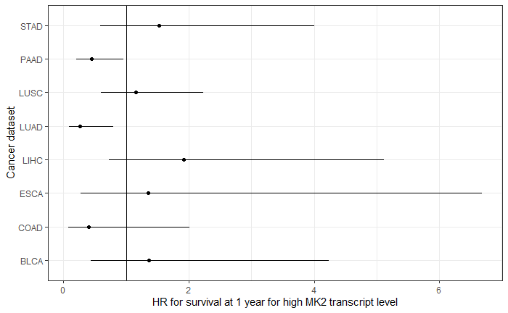
Forest plot showing Hazard ratio (and CI) for 1 year survival in patients with high MK2 transcript level (compared to low MK2 transcript level) in select early stage cancers. Interestingly, the phenomenon of lower HR is present only in lung adenocarcinoma (LUAD) and pancreatic adenocarcinoma (PAAD)

Slide 14
Extra slides

Slide 15
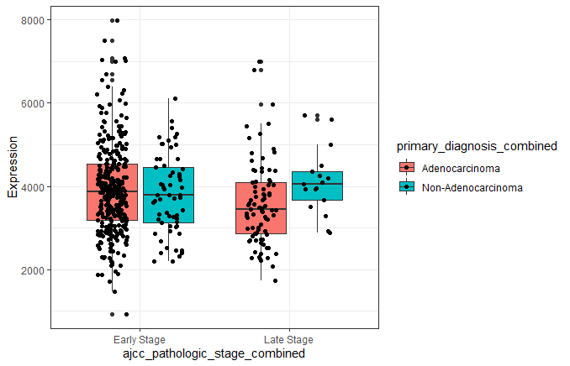
Boxplot show mean+/- SD of MK2 transcript levels in the TCGA-LUAD (Lung cancer) dataset subdivided by both stage and tumor histology. Though LUAD is a adenocarcinoma dataset, it does include some non-adenocarcinoma samples. We divided the tumor stage into Early (Stage I-IIB) and Late (Stage IIIA and IV). MK2 expression was extracted from TCGA mRNA sequencing data

Slide 16
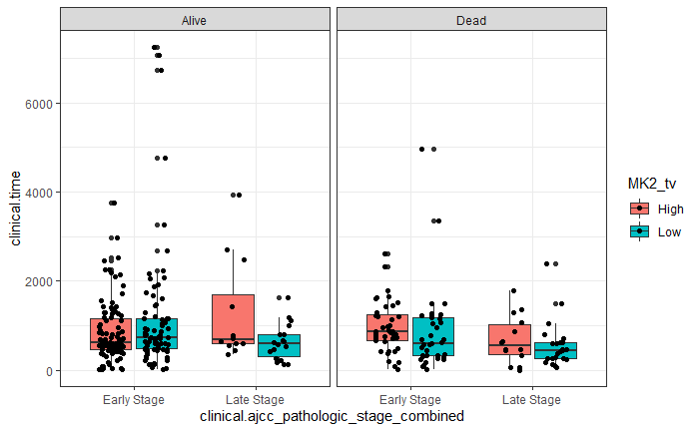
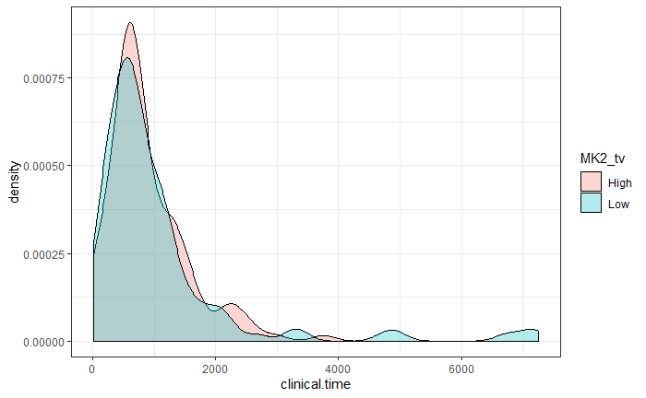
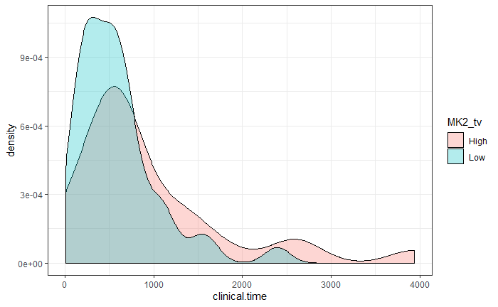
We’re interested in the impact of MK2 transcript level on survival. First, I wanted to make sure that the follow-up time was similar between
Early Stage
Late Stage
Boxplots showing follow-up time in patients with early and late Stage tumors, stratified by the status of the patient at the end of the follow-up time (Alive or dead). Right: Density plots showing no significant difference in the distribution of follow-up time in early stage patients, but a shorter overall follow-up time in the Low MK2 transcript level group in late stage cancer patients.

Slide 17
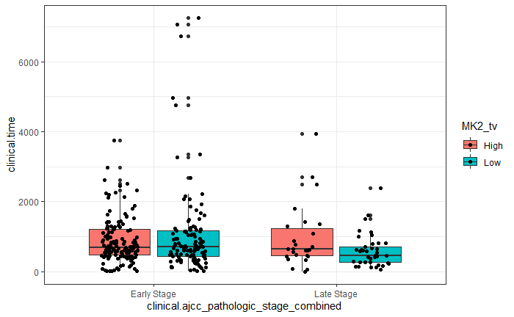
Follow-up time

